Slide 1


JS Framework VUE (Lecture 2)
Saturday 17:00 – 19:00

Slide 2


REVISE PREVIOUS LECTURE TOPIC
What is JavaScript?
What is Vue.js?
When added nullish operator in ECMA Script?
What ECMA Script version never released?
Is Vue 2 version consist of Composition API?

Slide 3
Virtual DOM
Let’s see the real example what is Virtual DOM: https://codepen.io/team/Vue/pen/KKNJKbw
A copy of the DOM in JavaScript, called a virtual DOM, is created because working with the DOM is computationally expensive in JavaScript. At the same time, performing updates in JavaScript is cheap, but finding the right DOM nodes and updating them is expensive. So a list of upcoming changes is collected and applied to the DOM at once.
The virtual DOM is a lightweight JavaScript object created by the render function. It takes three arguments: the element, an object with data, input parameters, attributes, and more, and an array. The array specifies the child elements, each of which also has three arguments, and they can also have their own children, and so on, until the full tree of elements is built.
When we need to update the list items, we do this via JavaScript, using the reactivity we mentioned earlier. Then all these changes are made to the JavaScript copy, i.e. the virtual DOM, and a comparison operation is performed with the original DOM. Only then are the updates determined. This is how the virtual DOM allows for productive UI updates!

Slide 4


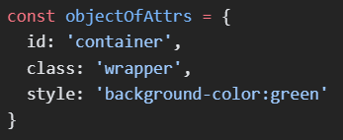
Templates
Vue uses HTML-based template syntax, that allows you to declaratively bind the rendered DOM to the underlying component instance’s data. All Vue templates are syntactically valid HTML that can be parsed by spec-compliant browsers and HTML parsers.
Vue templates is compiling into highly-optimized JavaScript code. Combined reactivity system, Vue can intelligently figure out the minimal number of components to re-render and apply the minimal amount of DOM manipulation when the app state changes.
Its openly described in Virtual DOM terminology
Text interpolation | Mustache syntax
Raw HTML | v-html directive
Attribute Bindings | v-bind

Slide 5
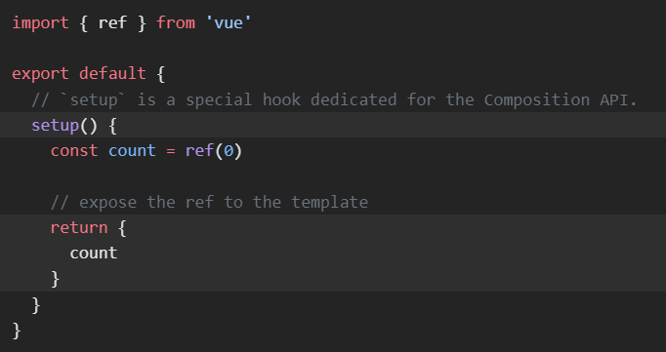
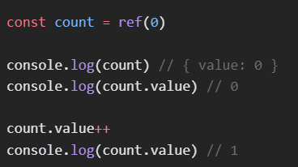
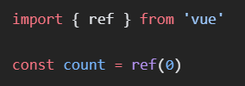
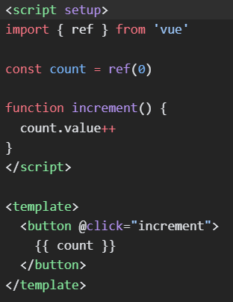
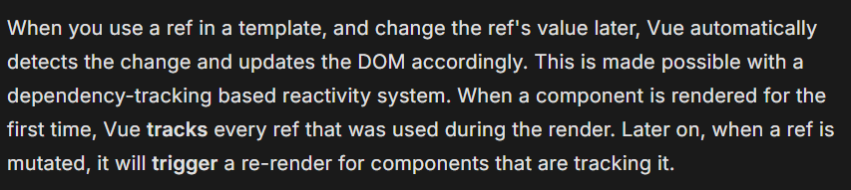
Reactivity fundamentals
Declaring Reactive state: In Composition API, the recommended way to declare reactive state is using the ref()
Setup: Manually exposing state and methods via setup() can be verbose. Luckily, it can be avoided when using Single-File Components (SFCs)
How it works?

Slide 6
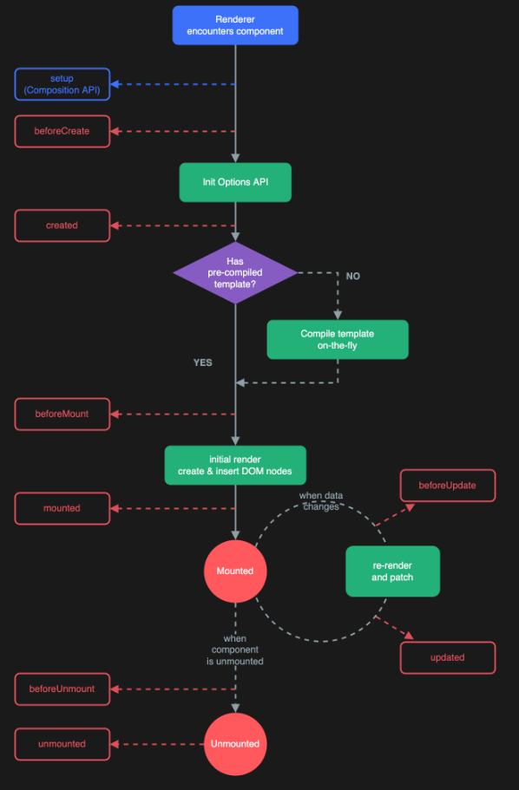
Lifecycle Hook
Each Vue component instance goes through a series of initialization steps when it's created - for example, it needs to set up data observation, compile the template, mount the instance to the DOM, and update the DOM when data changes. Along the way, it also runs functions called lifecycle hooks, giving users the opportunity to add their own code at specific stages.

Slide 7
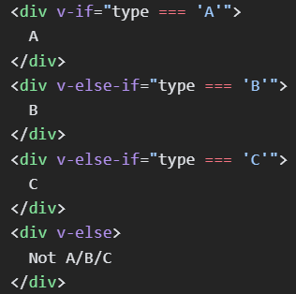
Conditional rendering
(v-if):
The directive v-if is used to conditionally render a block. The block will only be rendered if the directive's expression returns a truthy value.
(v-else-if)
The v-else-if, as the name suggests, serves as an "else if block" for v-if. It can also be chained multiple times
(v-else)
You can use the v-else directive to indicate an "else block" for v-if

Slide 8



List rendering
(v-for)
We can use the v-for directive to render a list of items based on an array. The v-for directive requires a special syntax in the form of item in items, where items is the source data array and item is an alias for the array element being iterated on
Inside the v-for scope, template expressions have access to all parent scope properties. In addition, v-for also supports an optional second alias for the index of the current item

Slide 9


Form input bindings
(@input)
When dealing with forms on the frontend, we often need to sync the state of form input elements with corresponding state in JavaScript. It can be cumbersome to manually wire up value bindings and change event listeners
The v-model directive helps us simplify the above to

Slide 10
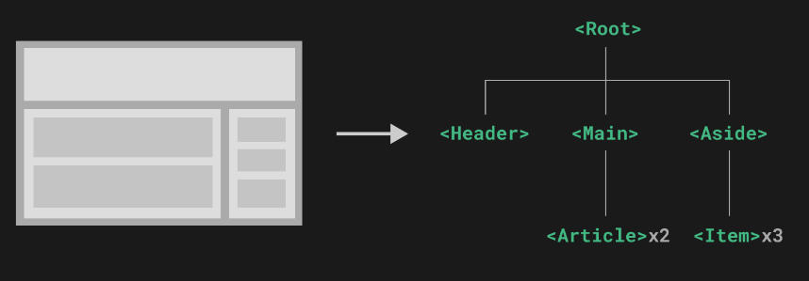
Components
Components allow us to split the UI into independent and reusable pieces, and think about each piece in isolation. It's common for an app to be organized into a tree of nested components:

Slide 11
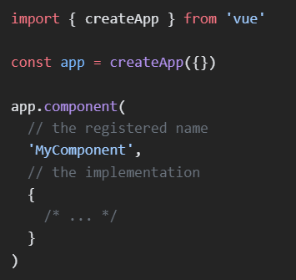
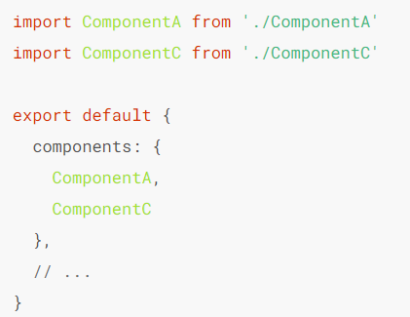
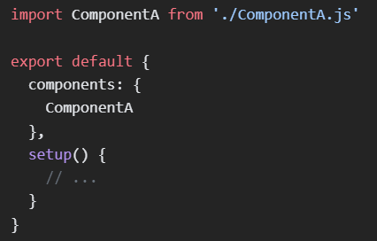
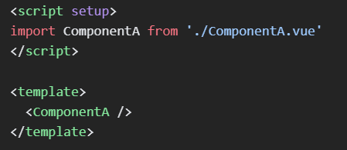
Components in advance
Component is using to encapsulate custom content and logic;
We define component as dedicated syntax (.vue) extension, known as (Single-File-Component SFC)

Slide 12
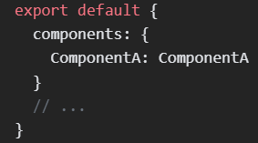
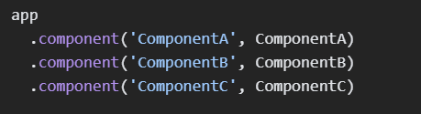
For each property in the components object, the key will be the registered name of the component, while the value will contain the implementation of the component
Locally registered components are not also available in descendant components. In this case, ComponentA will be made available to the current component only, not any of its child or descendant components
The .component() method can be chained:

Slide 13
Props
Vue components require explicit props declaration so that Vue knows what external props passed to the component should be treated as fall through attributes (which will be discussed in its dedicated section)
In SFCs using <script setup>, props can be declared using the defineProps() macro
In non-<script setup> components, props are declared using the props option

Slide 14
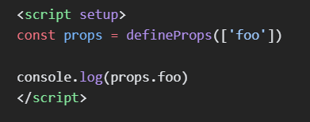
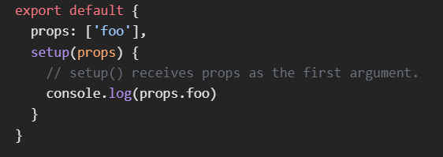
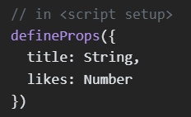
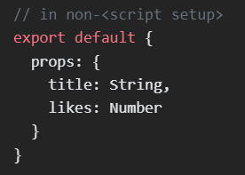
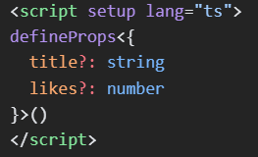
Notice! The argument passed to defineProps() is the same as the value provided to the props options: the same props options API is shared between the two declaration styles

Slide 15
Composables
In the context of Vue applications, a "composable" is a function that leverages Vue's Composition API to encapsulate and reuse stateful logic.
When building frontend applications, we often need to reuse logic for common tasks. For example, we may need to format dates in many places, so we extract a reusable function for that. This formatter function encapsulates stateless logic: it takes some input and immediately returns expected output. There are many libraries out there for reusing stateless logic - for example lodash (Array library) and date-fns (Datetime library), which you may have heard of.
By contrast, stateful logic involves managing state that changes over time. A simple example would be tracking the current position of the mouse on a page. In real-world scenarios, it could also be more complex logic such as touch gestures or connection status to a database.

Slide 16
Example
// mouse.js
import { ref, onMounted, onUnmounted } from 'vue’
// by convention, composable function names start with "use"
export function useMouse() {
// state encapsulated and managed by the composable
const x = ref(0)
const y = ref(0)
// a composable can update its managed state over time.
function update(event) {
x.value = event.pageX
y.value = event.pageY
}
// a composable can also hook into its owner component's // lifecycle to setup and teardown side effects.
onMounted(() => window.addEventListener('mousemove', update)) onUnmounted(() => window.removeEventListener('mousemove', update))
// expose managed state as return value
return { x, y }
}

Slide 17
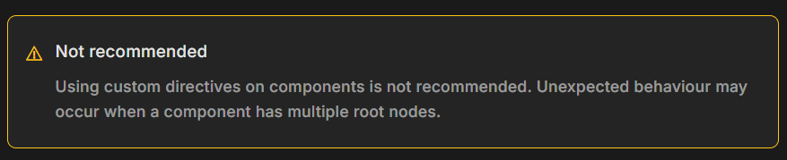
Directives
We already have directives shipped in core (Like v-model, v-show);
Vue allows you to register custom directives;
We have introduced two forms of code reuse in Vue: components and composables. Components are the main building blocks, while composables are focused on reusing stateful logic. Custom directives, on the other hand, are mainly intended for reusing logic that involves low-level DOM access on plain elements.

Slide 18
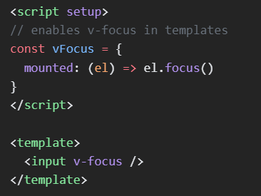

Slide 19
How to create custom directive?
Global method:
// main.js
Vue.directive('focus’,
{ // Когда привязанный элемент вставлен в DOM...
inserted: function (el) { // Фокусируем элемент
el.focus();
} });
new Vue({
el: '#app’,
render: h => h(App)
});
Local method:
export default {
directives: {
focus: { // Хук вставки в DOM inserted: function (el) {
el.focus();
}
}
}
};

Slide 20
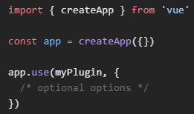
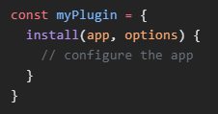
Plugins
Introduced as self-contained code that usually add app-level functionality to Vue.
How to install a plugin?
A plugin is defined as either an object that exposes an install() method, or simply a function that acts as the install function itself. The install function receives the app instance along with additional options passed to app.use()

Slide 21
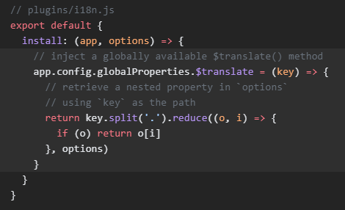
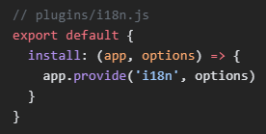
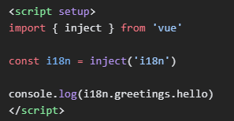
I18n Plugin (i18n.js)
Since this function should be globally available in all templates, we will make it so by attaching it to app.config.globalProperties

Slide 22
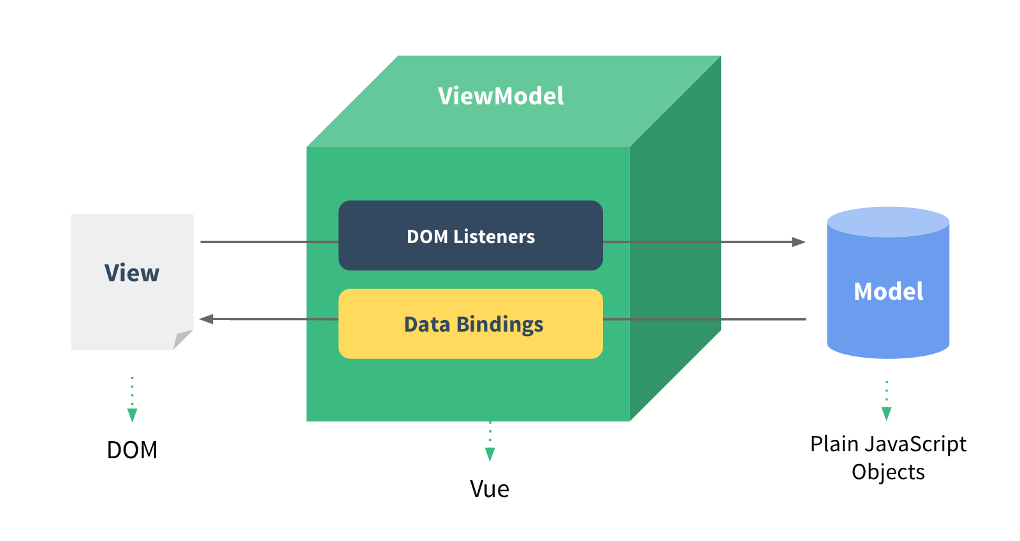
Conclusion
1. Virtual DOM – Principles?
2. What is Templates?
3. What is Reactivity in Vue?
4. Lifecycle Hooks is?
5. Conditional and List rendering
6. What is bindings?
7. What is directives?
8. Is root exist in components?
9. What mean “Composable”?

